Slide 1

Cloud Storage Vulnerabilities
Presented by: Jared Andraszek

Slide 2
Overview
What is cloud storage
Pros and Cons of cloud storage
What vulnerabilities exist
How to prevent against them

Slide 3
What is Cloud Storage?
Save data and files in an off-site location that you access through a network connection (IBM)
Public Cloud – Connect over the internet, managed by another company
Private Cloud – Connect over a dedicated network connection, managed by the company

Slide 4
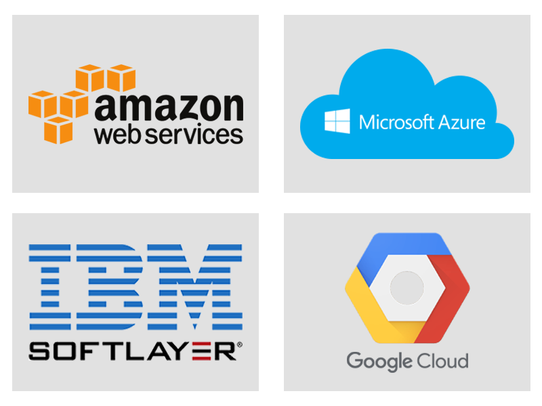
Public Cloud Examples
AWS
Microsoft
IBM SoftLayer
Google Cloud
(PublicCloudServices)

Slide 5
Pros and Cons with Cloud Storage
PROS
Disaster Recovery
High Availability of Data
Scalability
CONS
Requires access to the internet
Fixed Contracts
Lack of total control
(SecureStorageServices)

Slide 6
What Vulnerabilities Exist
Misconfiguration
Unpatched Web Services
Unsecure credentials
Privilege errors
(GoodChild, 2023)

Slide 7
Key Recommendations
Principle of Least Privilege
Patching
Vulnerability Scanning
(Kaduri, Silberman, 2023)

Slide 8
AWS Example
Allows easy multiple locations and servers
Differing level of user access (servers, audits, managerial)
System admin can make altercations to the servers
Easy to misconfigure or overspend on processes

Slide 9
Summary
What is cloud storage
Pros and Cons of cloud storage
What vulnerabilities exist
How to prevent against them

Slide 10
References
Goodchild, J. (2023, January 4). The cloud is under attack: The State Of Cloud Security in 2023. CSO Online. https://www.csoonline.com/article/574285/the-cloud-is-under-attack-the-state-of-cloud-security-in-2023.html#:~:text=67,vulnerabilities%20as%20top%20conduits%20for
Kaduri, B., &amp; Silberman, J. (2023, May 30). The top 5 cloud security risks of 2023 (so far). CSA. https://cloudsecurityalliance.org/blog/2023/05/30/the-top-5-cloud-security-risks-of-2023-so-far/
Pros and cons of cloud storage back. Secure Storage Services. (n.d.). https://www.securestorageservices.co.uk/article/11/pros-and-cons-of-cloud-storage
Public Cloud Services: Public Cloud Computing Consulting partner. Go to Veritis Group Inc. (n.d.). https://www.veritis.com/solutions/cloud/public-cloud-computing-services/
What is cloud storage?. IBM. (n.d.). https://www.ibm.com/topics/cloud-storage

Slide 11

Questions

